Slide 1





ML MODEL
TO PREDICT ROAD TYPES

Slide 2


Overview
WE ARE ON MAKING A MACHINE LEARNING MODEL WHICH IDENTIFIES THE ROAD TYPE AND THE PERIPHERY SUCH AS BUILDINGS, CARS ETC.
OBJECTIVES
GOALS
A MACHINE LEARNING MODEL WHICH AUTOMATICALLY IDENTIFIES THE TYPE OF ROAD BY GIVEN INPUTS
CATEGORIZATION OF ROAD TYPE INTO HIGHWAYS,ROADWAY,DIRT ROAD,ETC
Back to Agenda Page

Slide 3

ROAD MAP
DAY 1
DAY 2
DAY 3
MANUAL MODELTESTING
MULTIPLE PHOTO SHUFFLING AUTOMATED MODEL
WORKING ON API INTEGRATION
DATA SETS
TRAINING AND TESTING OF THE MANUAL MODELS
TRAINING AND TESTING OUR MODEL

Slide 4
RISKS
LESS THAN 100% ACCURACY
Write an item here.
Write an item here.
Back to Agenda Page

Slide 5
ML MODEL
ACCURACY
ERROR
PREDICTABILITY
90%
10%
90%
Last updated:
Last updated:
Last updated:
Back to Agenda Page

Slide 6
DATASETS
WE PROVIDED THE ML MODEL WITH IMAGES OF ALMOST EVERY INDIAN NATIONAL HIGHWAY.
THEN WE LOADED THOSE 350-400 DATASETS INTO THE SUFFLING MODEL FOR TRAINING AND IDENTIFICATION
Your paragraph text
Back to Agenda Page

Slide 7
LIBRARIES USED
WE USED VARIOUS LIBRARIES FOR THIS PROJECT
A)NUMPY
B)TENSORFL0W
C)KERAS
D)PANDAS
E)FLASK
F)OPENCV
G)GEE
Your paragraph text
Back to Agenda Page

Slide 8
SOFTWARES USED
A)VS CODE
B)JUPYTER NOTEBOOK
C)ADOBE PHOTOSHO
Your paragraph text
Back to Agenda Page

Slide 9
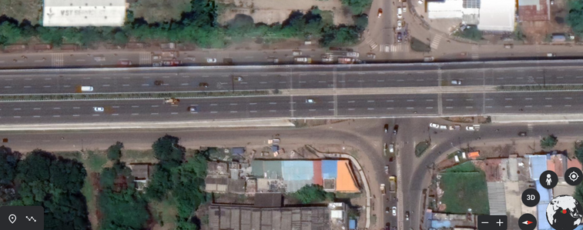
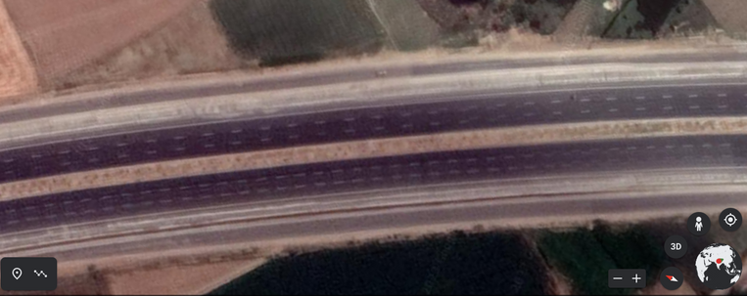
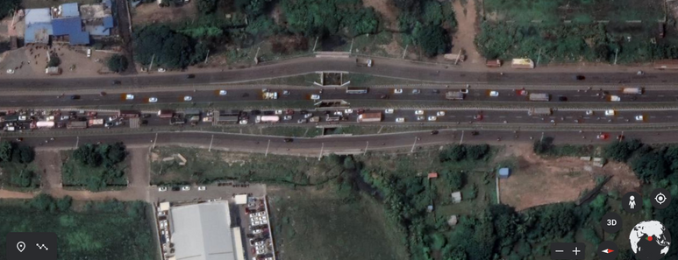
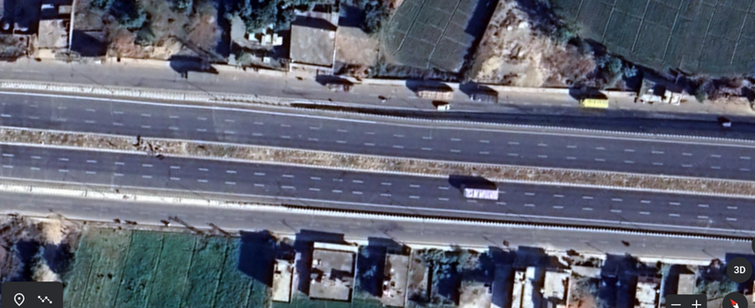
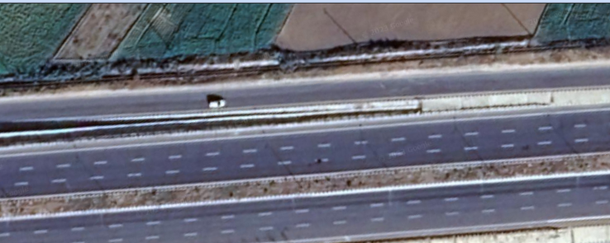
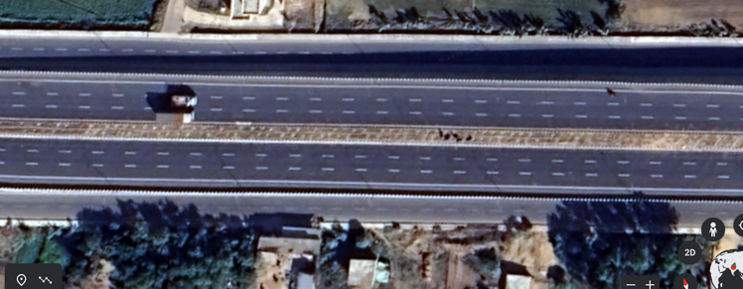
HIGHWAY ROAD DATASETS
SOURCED FROM GOOGLE EARTH ENGINE

Slide 10
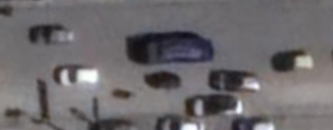
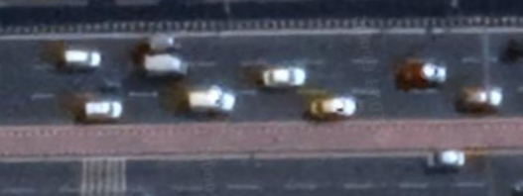
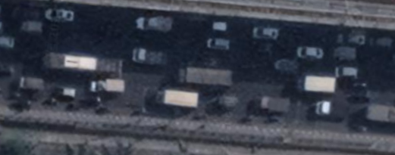
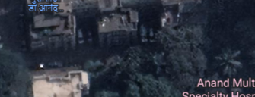
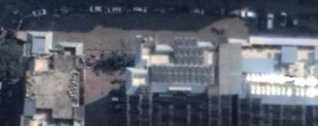
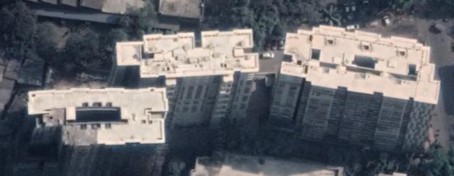
CAR
0BJECT DATASETS
SOURCED FROM GOOGLE EARTH ENGINE
BUILDINGS

Slide 11
